Slide 1
2019 GU oral
撰：中國醫 林亭君
校：北醫 劉正昇

Slide 2
三總 趙興隆 Prostate cancer

Slide 3
問題脈絡： Diagnosis 🡪 Work-up 🡪 Staging 🡪 Bone metastasis work-up and management
情境題：病患有 LUTS 症狀, 切片診斷 prostate cancer, 來找你做後續處理
Ask history: left hip pain, 沒有外傷病史, good PS, no comorbidity
DRE: bil firm nodules and left seminal vesicle induration
MRI: bil lobe involved, SV(-), no LN, r/o left hip bone lesion
PSA…, Bone scan: r/o left hip uptake
2021 詳解答：
History, PE, DRE, PSA for all prostate cancer patients
Imaging study for the symptomatic patient: bone imaging
Determine life expectancy

Slide 4
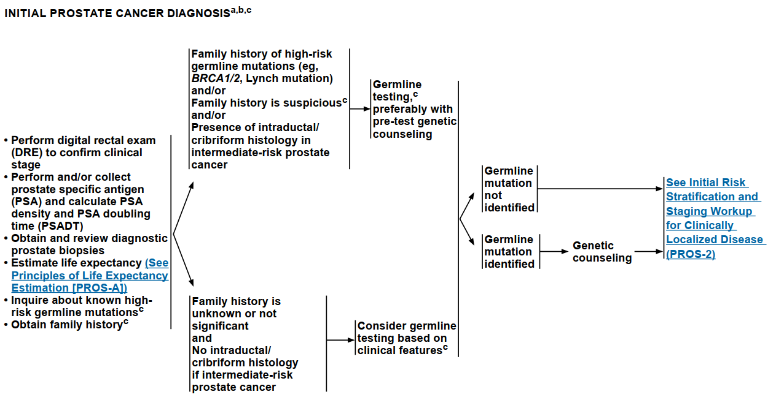
NCCN 2.2021

Slide 5
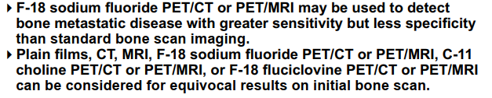
Bone scan (+) 是否為轉移？
答 團隊會議討論 (趙 團隊會議也是問你覺得是不是), Bx proved (趙 病人不要呢? 有沒有做Bx有差嗎?)
2021 詳解答：
Biopsy of metastatic lesion
Consider bone imaging with higher sensitivity, such as NaF scan
NCCN 2.20201 PROS-C

Slide 6
Staging T3bN0M1b，治療策略？
ADT + Docetaxel or abiraterone
趙:你確定要這樣做? NCCN是這樣寫嗎….
因為 low tumor burden 可以考慮 ADT + primary RT, RT field/dose
2021 詳解答：
Evaluate whether the disease is low-volume or high-volume (CHAARTED, as NCCN cited)
Treat primary tumor for low volume M1
Local: RT Field and dose as STAMPEDE
Systemic: ADT + LHRH agonist/-antagonist/orchiectomy
ADT alone, or ADT + apalutamide/abiraterone/docetaxel/enzalutamide (all NCCN category 1)

Slide 7
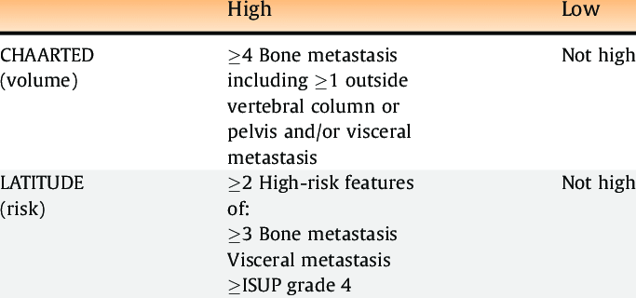
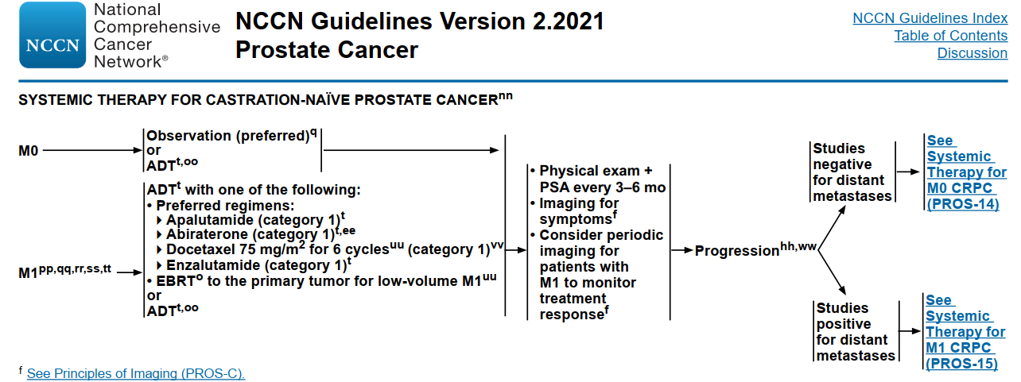

Slide 8
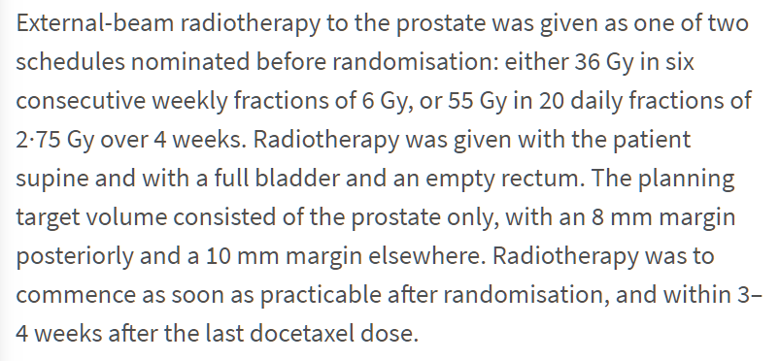
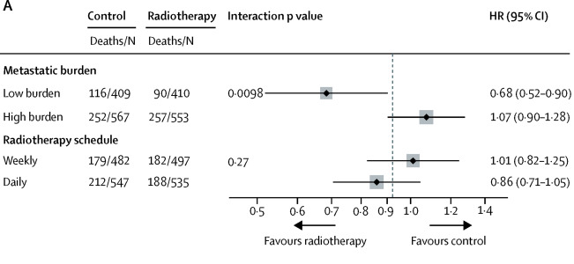
STAMPEDE (Lancet 2018)
OS benefit for low burden M1 when prostate RT given
“Overall survival was improved in patients with low metastatic burden at baseline who were allocated radiotherapy (HR 0·68, 95% CI 0·52–0·90; p=0·007; 3-year survival 73% with control vs 81% with radiotherapy”

Slide 9
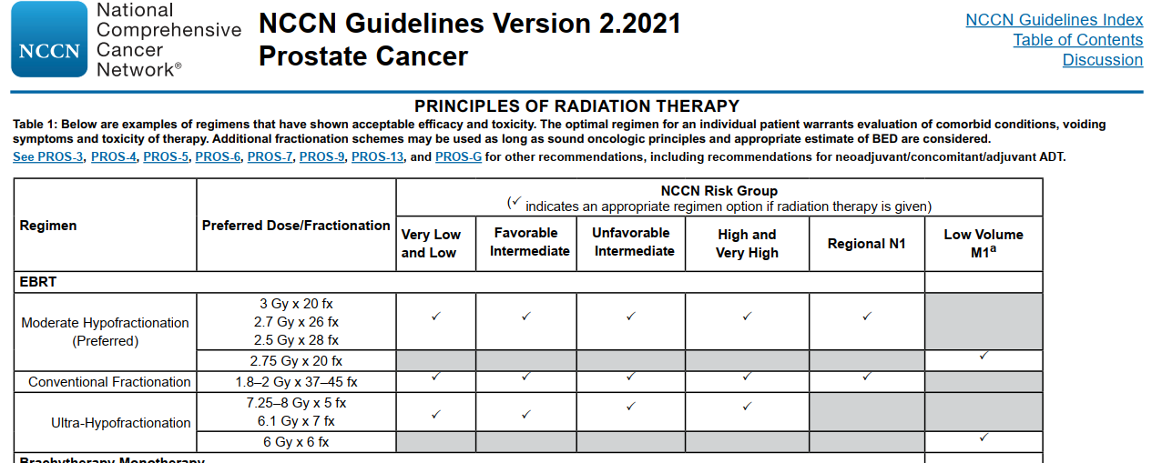

Slide 10
Bone lesion 是否要處理？
該病人最後拒絕治療, 兩年後左邊下背痛回來找你
安排Bone scan (趙 你想看什麼懷疑什麼…), Hx, PE (先排除非cancer), CT
2021 詳解答：
Bone imaging with plain film/CT/MRI/SPECT, or consider NaF-18/C-11 choline for higher sensitivity
The patient refused initial treatment 🡪 castration-naïve M1

Slide 11
中國醫 梁基安 Bladder cancer

Slide 12
小附註：敝科主任問問題風格一向貴多不貴精，偏好一次問多個小題目以及臨床病例；guideline 熟悉已足夠，不著重背誦 trial。
一位病患開完 TURBT 後, 病理顯示是 urinary bladder cancer, 腫瘤侵犯 lamina propria, high-grade, 期別是? 常見的病理是? 接下來的處理方式是?
2021 詳解答：
T1
Most common histopathology: urothelial carcinoma (old term: transitional cell carcinoma, TCC)
Treatment: T1 high grade = high risk 🡪 repeat TURBT 🡪
For very high risk (LVI, variant, extensive CIS, prostate urethra+): cystectomy
For other: BCG (NCCN category 1)

Slide 13
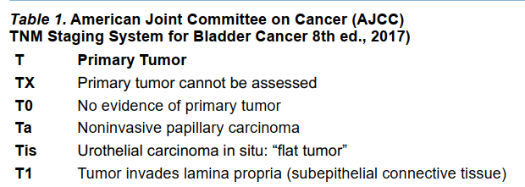
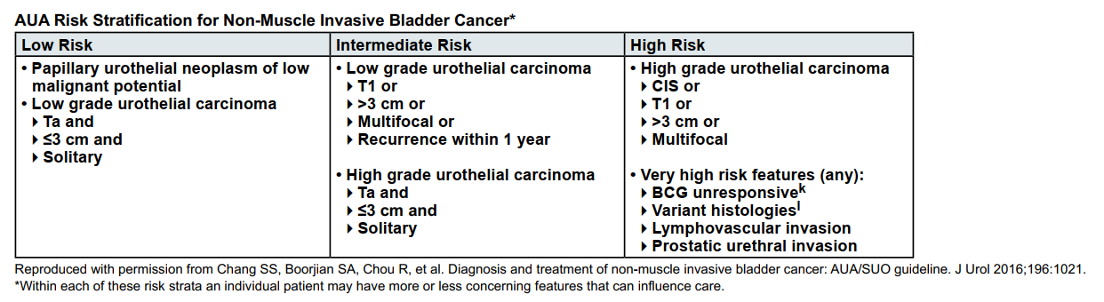

Slide 14
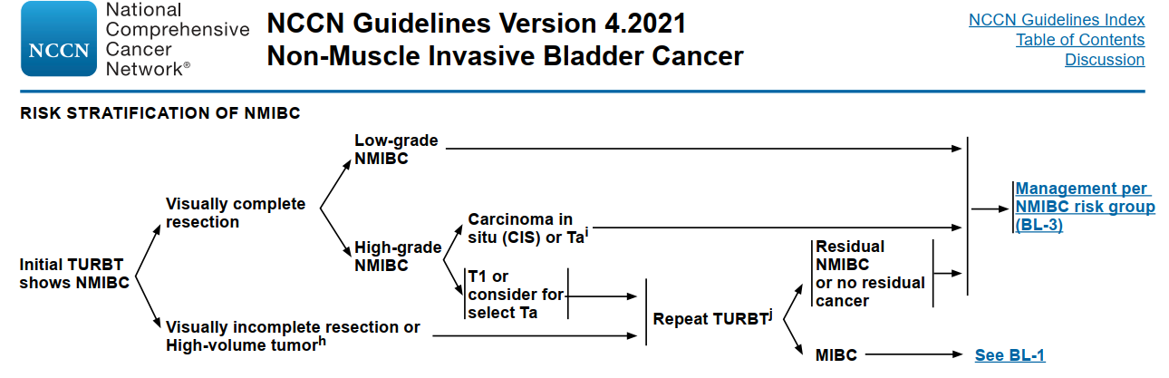

Slide 15
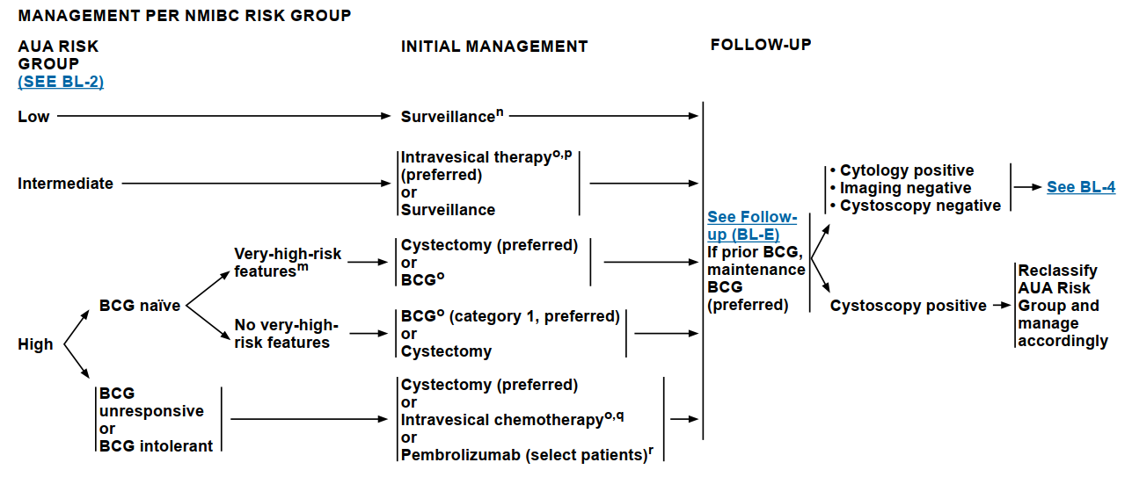

Slide 16
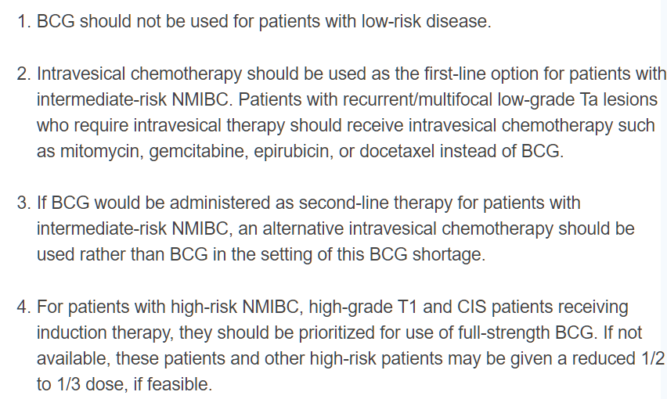
如果需要intravesical BCG, 但BCG不夠怎麼辦?
2021 詳解答：
BCG shortage: AUA notice
Use alternative such as chemo
Use reduced induction dose

Slide 17
一位病患開完TURBT後, 病理顯示是urinary bladder cancer, 腫瘤侵犯deep muscularis propria, cTN是? Stage是? 簡述organ preservation的做法, RT的照射範圍、劑量、照完幾Gy要做TURBT、根據TURBT的發現簡述之後處置
2021 詳解答：
T2b (T2bN0M0 = Stage II)
Organ preservation CCRT:
doublet chemo preferred: cisplatin + 5-FU most commonly applied in recent RTOG trials
RT field and dose: whole bladder +/- pelvic lymphatics for 39.6-50.4 Gy; boost partial or whole bladder to 60-66 Gy [BC2001]
舊版 guideline organ preservation CCRT 建議治療四週後 cystoscopy reassessment (restaging TUR)，但現已不建議中斷 CCRT。

Slide 18
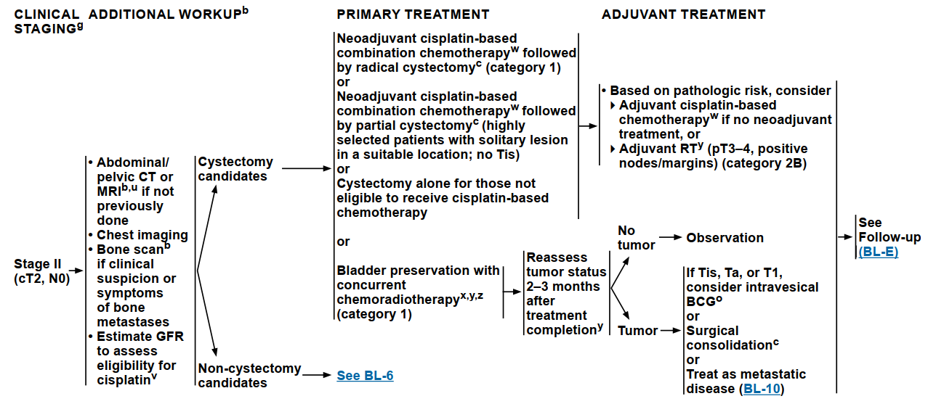

Slide 19
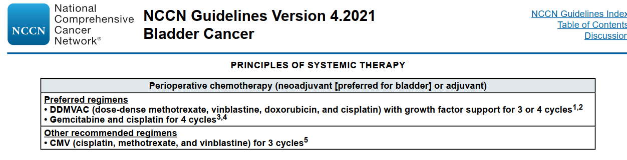
一位病患開完TURBT後, 病理顯示是urinary bladder cancer, macroscopic perivesical invasion, 影像學上左右各一顆internal iliac LN(+), cTN是? Stage是? 簡述之後的治療方式有哪些? 如果選擇neoadjuvant chemotherapy, 有哪些regimens? 你們醫院用哪種?
2021 詳解答：
T3bN2M0, Stage IIIB
Downstaging chemo: DDMVAC, GC, CMV

Slide 20
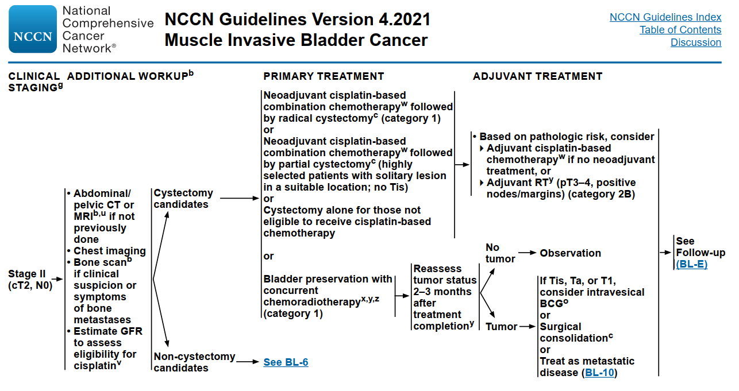
Urinary bladder cancer stage II and IIIA做完neoadjuvant chemotherapy過後, 有哪些 pathological risk factors 要做術後 RT?
2021 詳解答：
pT3-4, N+, margin+

Slide 21
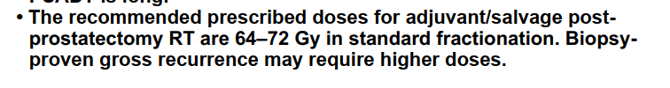
一位病患prostate cancer, 術後顯示 pT3N0, extraprostatic extension, 會不會給術後 RT, 如果會那照射範圍是? 放射線劑量給多少?
2021 詳解答：
In 2020, 3 trials were published discussing “adjuvant RT vs. salvage RT for prostate cancer”: RADICALS-RT, GETUG-AFU 17, RAVES. Overall, no benefit found for adjuvant RT, and ealy salvage should be considered SOC. However, patients with very high risk features consisted only a very small portion in these trials. Adjuvant RT may perhaps be considered for those with GS 9-10, pT3b or higher, pelvic LN(+), and detectable post-RP PSA; and also for pts who do not receive ADT.
RT field and dose: prostate fossa(bed) +/- pelvic LN; total to 64-70 Gy
NCCN 2.2021 Principles of RT

Slide 22
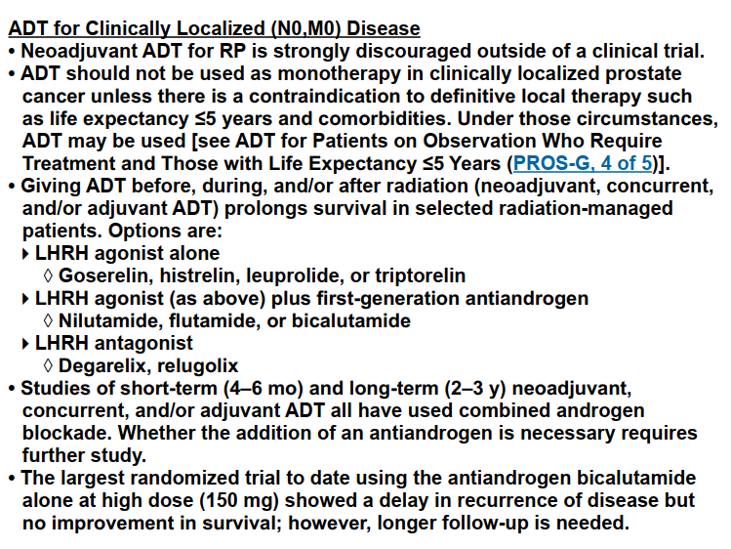
一位病患 prostate cancer, 符合可以做達文西手術, 也符合可以做放射線治療的條件, 在做達文西手術前可以先給 ADT 嗎? 做 RT 前可以先給 ADT 嗎?
2021 詳解答：
2021 NCCN guideline: ADT should NOT be used as neoadjuvant tx for RP out of clinical trial; however, neoadjuvant/concurrent/adjuvant ADT is encouraged for pts receiving RT.

